Slide 1
Chapter 13 Classification of Organic compounds
Wilt Gu

Slide 2
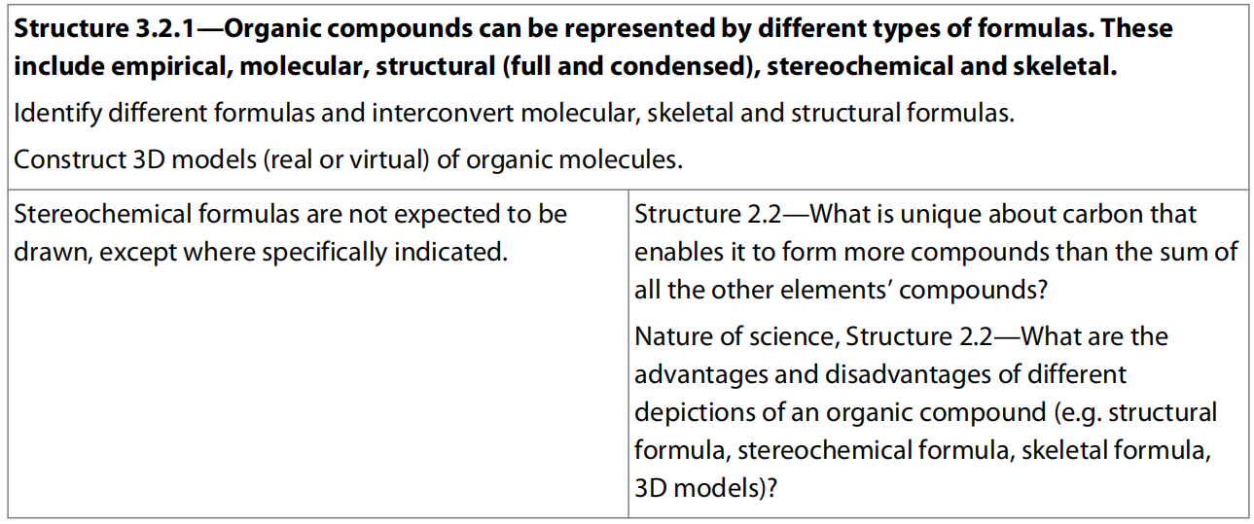
13.1 Fundametals of organic compounds

Slide 3
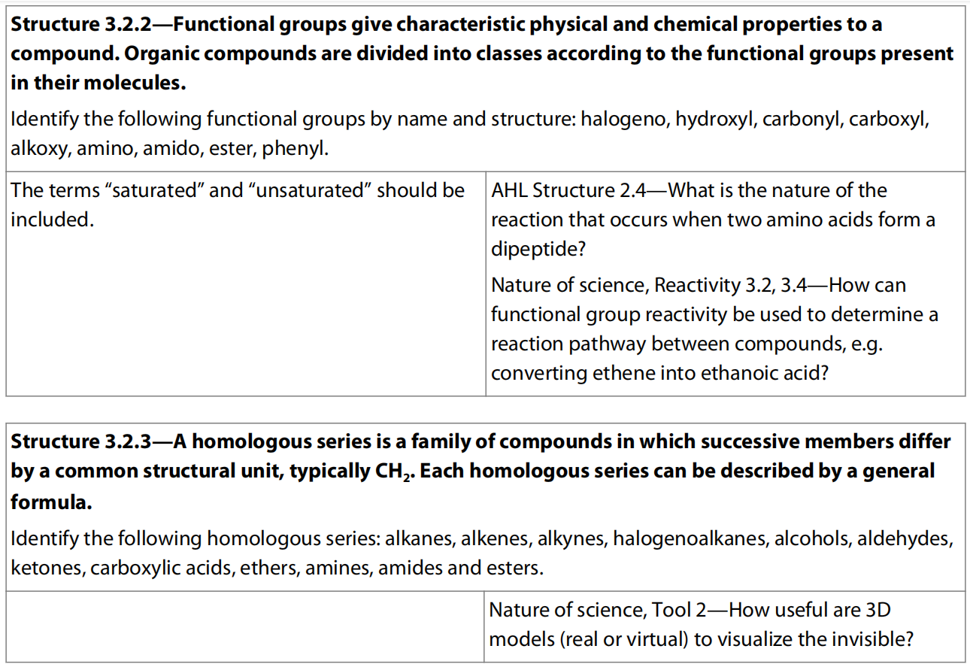

Slide 4
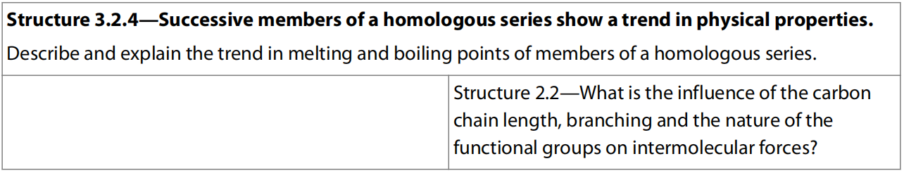

Slide 5
What is organic chemistry?
Organic chemistry is one of the major branches of chemistry. It includes the study of:
all biological molecules – from simple sugars to complex nucleic acids
all fossil fuels – including oil, coal, and natural gas
nearly all synthetic materials – such as nylon, Lycra®, and Gore-Tex®
many domestic and industrial products – such as paints, detergents, and refrigerants.

Slide 6
Definition of organic compounds
Originally from “organic” meaning life
Not just chemistry of life, but CHEMISTRY OF CARBON
Exceptions:
oxides of carbon (CO₂, CO)
carbonates, bicarbonates (NaHCO₃,CaCO₃)
cyanides, cyanate (NaCN, etc.)
carbides (CaC₂, etc.)

Slide 7
Why Carbon?
Group 4/14
Has 4 valence electron (2,4 or 1s²2s²2p²) which allows each carbon atoms to form up to 4 other bonds
Can form single, double or triple bond
Can form bond to itself, forming long chain (process known as catenation) and rings of carbon atom (cyclic molecule)
Forms tetrahedral when its single bonded
Stable compounds due to strength and stability C-C = 348 KJ mol⁻¹ and C-H = 412 KJ mol⁻¹
Can bond to a range of other elements including hydrogen, oxygen, nitrogen, sulfur and chlorine.

Slide 8
/Aromatics

Slide 9
Formulas for organic compounds: empirical, molecular, structural, and Skeletal
The empirical formula of a compound is the simplest whole number ratio of the atoms it contains.
For example, the empirical formula of ethane, C₂H₆, is CH₃.
This formula can be derived from percentage composition data obtained from combustion analysis.
It is of rather limited use on its own, as it does not tell us the actual number of atoms in the molecule.

Slide 10
The molecular formula of a compound is the actual number of atoms of each element present in a molecule.
For example, the molecular formula of ethane is C₂H₆. It is therefore a multiple of the empirical formula, and so can be deduced if we know both the empirical formula and the molar mass M.
The relationship can be expressed as:
M = (molar mass of empirical formula)_{n}
where n is an integer.

Slide 11
So, for example, if we know that the empirical formula of ethane is CH₃, and its molar mass M = 30 g mol⁻¹, using the formula above:
30 g mol⁻¹ = (mass of CH₃)_{n} so 30 = (12 + (3 × 1))n, which gives n = 2
Therefore the molecular formula of ethane is (CH₃)₂ or C₂H₆.
However, the molecular formula is also of quite limited value as the properties of a compound are determined not only by the atoms it contains, but also by how those atoms are arranged in relation to each other and in space.

Slide 12
The structural formula is a representation of the molecule showing how the atoms are bonded to each other. There are variations in the amount of detail this shows.
There are several types of structural formulae to show different extent of details of the molecular structures including full structural formula, condensed structural formula, skeletal formula, and stereochemical formula.

Slide 13
A full structural formula (graphic formula or displayed formula) shows every bond and atom. Usually 90° and 180° (and 120° ) angles are used to show the bonds because this is the clearest representation on a two-dimensional page, although in most cases this is not the true geometry of the molecule.
A condensed structural formula often omits bonds where they can be assumed, and groups atoms together. It contains the minimum information needed to describe the molecule non-ambiguously – in other words there is only one possible structure that could be described by this formula.

Slide 15
A skeletal formula omits carbon and hydrogen atoms and only use dashes to represent any bonds, but other atoms or functional groups are all shown clearly in the formula.

Slide 16
A stereochemical formula attempts to show the relative positions of atoms and groups around carbon in three dimensions.
The convention is that a bond sticking forwards from the page is shown as a solid, enlarging wedge, whereas a bond sticking behind the page is shown as a hashed line.
A bond in the plane of the paper is a solid line.
When carbon forms four single bonds, the arrangement is tetrahedral with bond angles of 109.5°; when it forms a double bond, the arrangement is triangular planar with bonds at 120°.

Slide 17
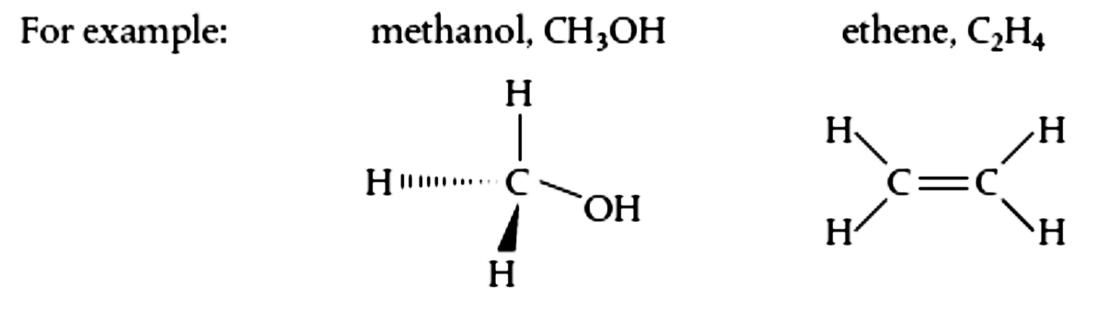
Sometimes we do not need to show the exact details of the hydrocarbon, or alkyl, part of the molecule or this part can change or not sure, so we can abbreviate this to R.
For molecules which contain a benzene ring, C₆H₆, known as aromatic compounds, we use to show the ring.

Slide 18
The degree of unsaturation / IHD
The degree of unsaturation or index of hydrogen deficiency (IHD) provides a useful clue to the structure of a molecule once its formula is known.
It is a measure of how many molecules of H₂ would be needed in theory to convert the molecule to the corresponding saturated, non-cyclic molecule.

Slide 19
Cyclohexane and hex-1-ene, for example, have the same molecular formula (C₆H₁₂) and so have the same degree of unsaturation and IHD.
One molecule of hydrogen is needed to convert them to the saturated alkane hexane (C₆H₁₄).
Similarly ethene, with a double bond, has an IHD of 1 whereas the more unsaturated ethyne, with a triple bond, has an IHD of 2.
The IHD values of a selection of molecules are tabulated below.

Slide 21
IHD
0
1
2
0
0
1
1
1

Slide 22
IHD
1
1
0
2
4

Slide 23
General equation for calculating IHD
There is a very useful Formula to calculate the IHD of any organic molecule with the molecular formula of C_{c}H_{h}N_{n}O_{o}X_{x}.
IHD = ½ × [2c + 2 − x + n − h ]
Why the number of O atom is not included?
Since O will form 2 bonds and so will form –OH, which has the same effect as a H atom directly bonded to the main chain.

Slide 24
Exercises:
C₆H₅NO₂
C₈H₄O₂Cl₂
C₁₂H₂₂O₁₁
C₆H₁₂O₆
C₂₀H₃₂Br₂N₂O₃
IHD = ½×(2×6+2-5+1) = 5
IHD = ½×(2×8+2-4-2) = 6
IHD = ½×(2×12+2-22) = 2
IHD = ½×(2×6+2-12) = 1
IHD = ½×(2×20+2-32-2+2) = 5

Slide 25
IHD = 5
IHD = 2
IHD = 6

Slide 26
IHD = 20

Slide 27
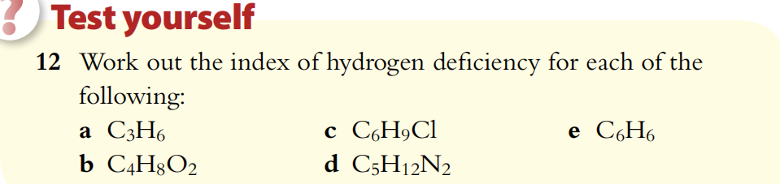
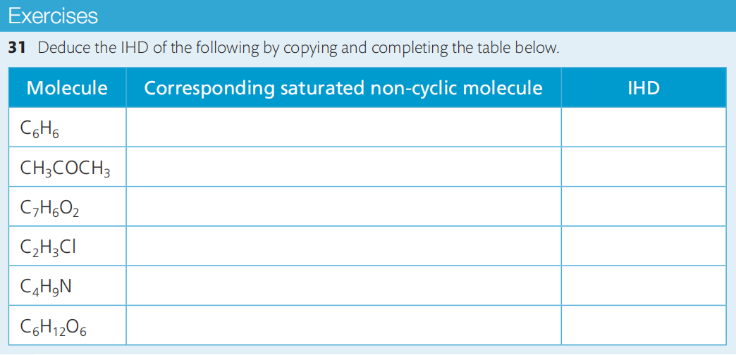

Slide 28
Homologous Series
Homologous Series – a group of organic compounds with the same and same number of functional group(s).
Features:
Successive compounds differ from each other by a –CH₂ – unit (known as the methylene group)
Compounds can be represented by a general formula
Compounds have similar chemical properties
Successive compounds have physical properties that vary in a regular manner as the number of carbon atoms present increases

Slide 29
Successive members of a homologous series differ by a -CH₂- group
Consider the following compounds of carbon and hydrogen where the carbons are all bonded only by single covalent bonds.

Slide 30
These are members of a homologous series known as the alkanes. It can be seen that neighboring members differ from each other by –– CH₂ ––.
Anything else in an organic compound is considered as a functional group, including any atoms other than carbon and hydrogen, and multiple bonds.
This same increment applies to successive members of each homologous series, and means that the molecular mass increases by a fixed amount as we go up a series.

Slide 31
Members of a homologous series can be represented by the same general formula
The four alkanes shown above can all be represented by the general formula C_{n}H_{2n+2}.
Other homologous series are characterized by the presence of a particular functional group, and this will be shown in the general formula for the series.
For example, the homologous series known as the alcohols possess the functional group –– OH as shown below.

Slide 32
These compounds can be represented by the general formula C_{n}H_{2n+1}OH.
The functional group is usually a small group of atoms attached to a carbon atom in a molecule, and it gives the characteristic properties to the compound.
In the situation of alcohols the functional group of them is hydroxyl group (-OH).

Slide 33
Members of a homologous series show a gradation in physical properties
As successive members of a homologous series differ by a –CH₂– group, they have successively longer carbon chains.
This is reflected in a gradual trend in the physical properties of the members of the series.
For example, the effect of the length of the carbon chain on the boiling point of the alkanes is shown in the table.

Slide 34
Other physical properties that show this predictable trend with increasing carbon number are density and viscosity.

Slide 35
Members of a homologous series show similar chemical properties
As they have the same functional group, members of the same homologous series show similar chemical reactivity.
E.g.: The alcohols have the –OH group, which can be oxidized to form organic acids
The –COOH group, present in the homologous series of the carboxylic acids, is responsible for the acidic properties of these compounds.
It follows that if we know the characteristic reactions of a functional group, we will be able to predict the properties of all members of the same homologous series.

Slide 36
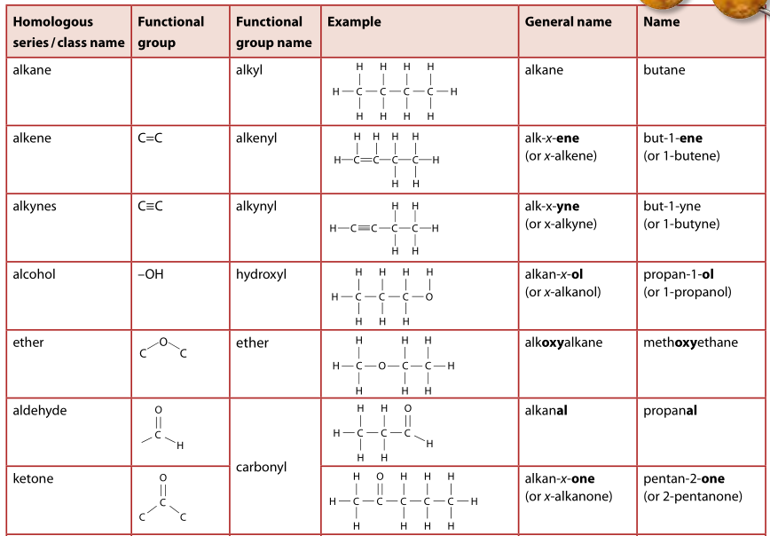
Common functional groups

Slide 37
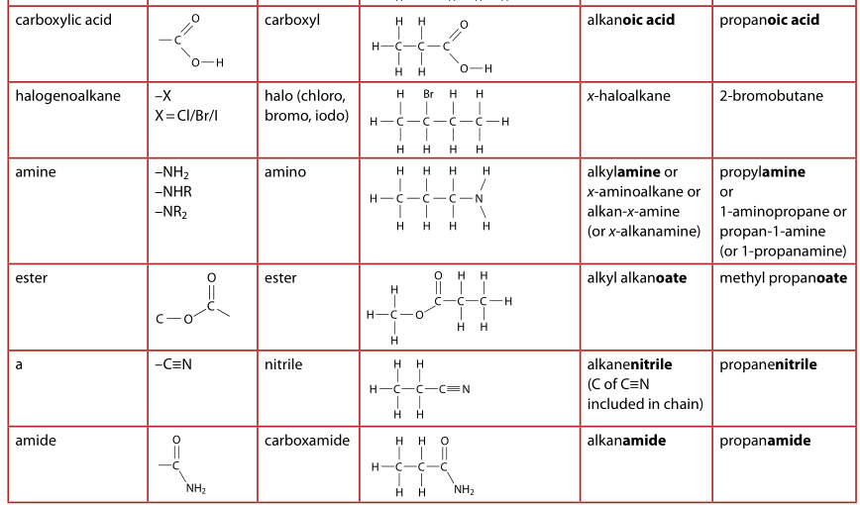
nitrile

Slide 38
Arenes
Arenes are a class of compounds that are derived from benzene, C₆H₆.
They form a special branch of organic compounds known as the aromatics, which have properties somewhat distinct from other organic compounds, which are known as aliphatics.
Arenes contain the phenyl functional group:

Slide 39
Primary, secondary, and tertiary compounds
The activity of a functional group is often influenced by its position in the carbon chain, identified as follows.
A primary carbon atom is attached to the functional group and also to one carbon atom.
Molecules with this arrangement are known as primary molecules.
For example, ethanol, C₂H₅OH, is a primary alcohol and chloroethane, C₂H₅Cl, is a primary halogenoalkane.

Slide 40
A secondary carbon atom is attached to the functional group and also to one hydrogen atom and two alkyl groups.
These molecules are known as secondary molecules.
For example, propan-2-ol, CH₃CH(OH)CH₃, is a secondary alcohol, and 2-chloropropane, CH₃CHClCH₃, is a secondary halogenoalkane.

Slide 41
A tertiary carbon atom is attached to the functional group and is also bonded to three alkyl groups and so has no hydrogen atoms.
These molecules are known as tertiary molecules.
For example, methylpropan-2-ol, (CH₃)₃COH, is a tertiary alcohol, and 2-chloro-2-methylpropane, (CH₃)₃CCl, is a tertiary halogenoalkane.

Slide 42
In amines, a similar classification can be applied according to the number of alkyl groups and hydrogen atoms bonded to the nitrogen atom.

Slide 43
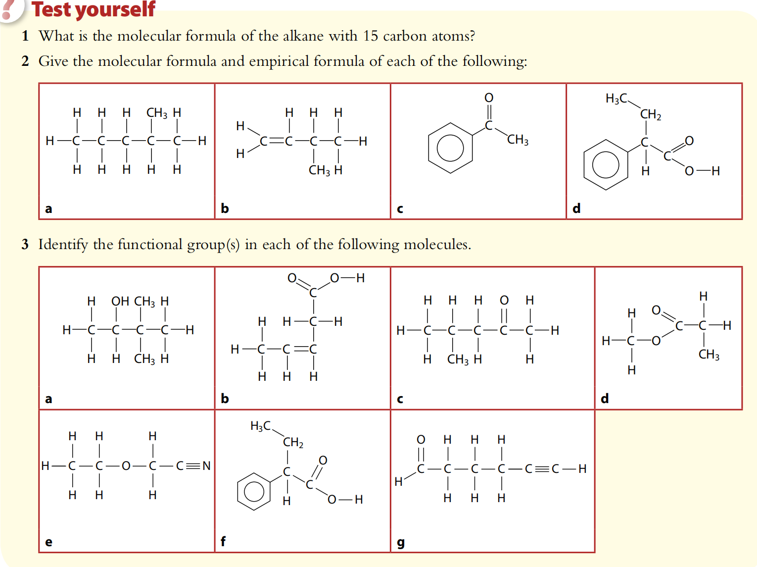

Slide 44
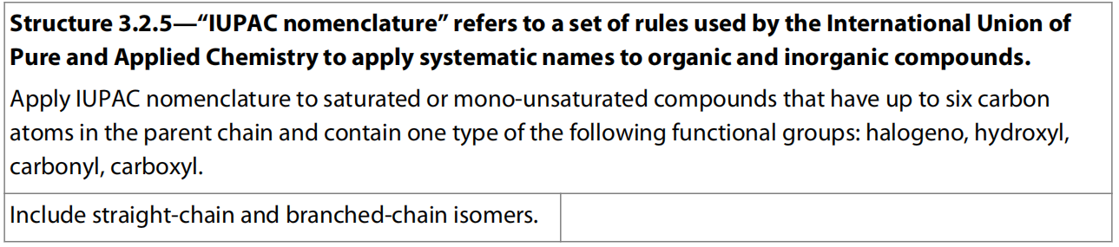
13.2 Nomenclature of organic compounds

Slide 45
Nomenclature for organic compounds: the IUPAC system
For over a hundred years, chemists have recognized the need for a specific set of rules for the naming of organic compounds.
IUPAC (International Union of Pure and Applied Chemistry) names are logically based on the chemistry of the compounds, and so give information about the functional groups present and the size of the molecules.
Some guidelines for applying the IUPAC nomenclature are discussed next.

Slide 46
In summary, IUPAC nomenclature has three possible parts, which are usually written together as a single word, using hyphens to separate number and letters and commas to separate numbers.
3,3-dimethylbutanal

Slide 47
Naming Strategy
1. Identify all the functional groups in the molecule and then identify the main functional group [see the priority sequence or in IB just find the one that can only be used as suffix in the naming (carboxyl, carbonyl, ester, amide, nitrile, alkenyl, alkynyl), if none then find the one that can be used as both suffix and prefix (hydroxyl, amino, phenyl), if none then any other groups (halogens, ether, nitro)];
2. Identify the longest continueous carbon chain with ALL the functional groups;
3. Number the longest continueous carbon chain making sure the number of the main functional group to be lower;
4. Identify the number of all the other functional groups and alkyl groups, making sure to combine any same groups using di-, tri-, etc., and rank the groups according to alphabet order;
5. Write down the name.

Slide 48
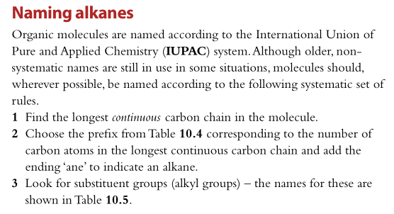
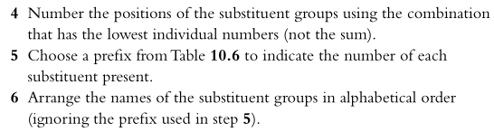

Slide 49
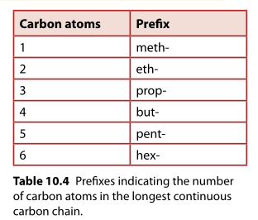
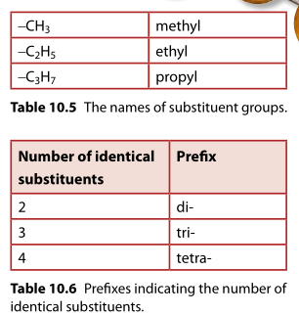

Slide 50
Rule 1: Identify the functional group(s)
The functional group usually determines the specific ending or suffix to the name, which replaces the ‘–ane’ ending in the parent alkane (when there is no functional group in the whole molecule).
The suffixes used for some common functional groups are shown in the table below.
Note the distinction between class, which refers to the type of compound, and functional group, which refers to the site of reactivity in the molecule.

Slide 52
nitrile

Slide 53
Functional Group Priority Series (not required)
Carboxylic acid (-COOH) > (sulfonic acid (-SO₃H)) > ester (-COOR) > (acyl halide (-COCl)) > amide (-CONH₂) > (anhydride (-COOCOR)) > nitrile (-CN) > aldehyde(-CHO) > ketone (-COR) > alcohol (-OH) > (phenol (-C₆H₄OH)) > amine (-NH₂) > alkene (-C=C-) > alkyne (-C≡C-) > ether (-CH₂OR) > alkane > halogen (-X) > nitro (-NO₂) > (nitroso (-NO))

Slide 54
Rule 2: Identify the longest carbon chain with functional group(s) (if applicable)
The longest continuous carbon chain with the main functional group gives the stem of the name as follows.

Slide 55
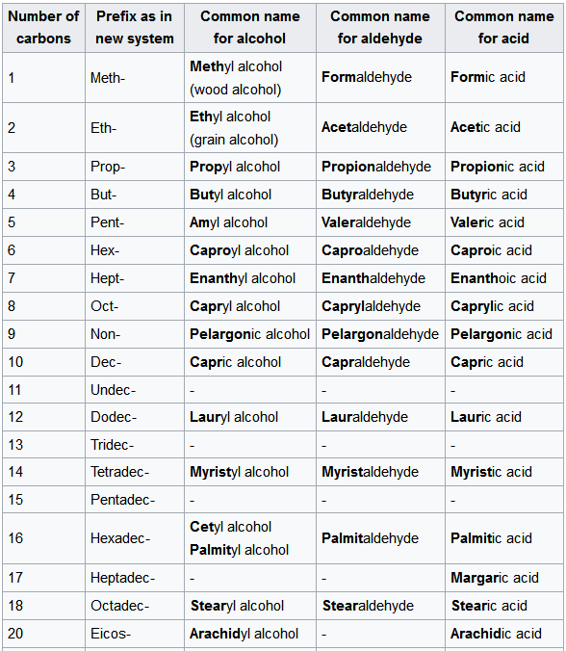
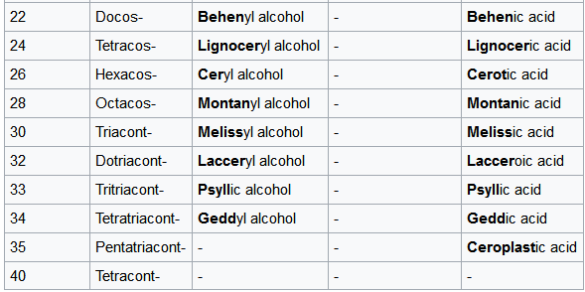

Slide 56
Note that ‘carbon chain’ refers to continuous or unbranched chains of carbon atoms – it does not mean angles of 180°.
Be careful when identifying the longest carbon chain not to be confused by the way the molecule may appear on paper, because of the free rotation around carbon–carbon single bonds.
For example, in the diagram below, all three structures are the same molecule pentane, C₅H₁₂, even though they may look different.

Slide 57
Esters form when the alkyl group of an alcohol replaces the hydrogen of a carboxylic acid in a condensation reaction: R–COOH + ROH → R–COO–R + H₂O
They are named in a similar way to salts, which form when a metal has replaced the hydrogen of a carboxylic acid.
Salts take the stem of the name from the parent acid. For example, C₂H₅COONa is sodium propanoate. In esters, the alkyl group of the alcohol is the prefix, so C₂H₅COOCH₃ is methyl propanoate.

Slide 58
Rule 3: Identify the side chains or substituent groups
Side chains, or functional groups in addition to the one used as the suffix, are known as substituents and are given as the first part or prefix of the name. Some common examples are shown in the table.
amino
alcohol —OH hydroxyl hydroxy
arene —C₆H₅ phenyl phenyl

Slide 60
You will notice that –NH₂ and –OH appear as both a possible suffix amine / ol and a prefix amino / hydroxy.
Usually when it is the only functional group it will take the suffix amine / ol, but if there are two or more functional groups in the molecule it will be a prefix amino / hydroxy, as for example in amino acids and lactic acid.

Slide 61
Rule 4: Number the carbon chain making sure lower number is given to the main functional group
The position of a functional group is shown by a number between dashes inserted before the functional group ending.
The number refers to the carbon atom to which the functional group is attached.
The chain is numbered starting at the end that will give the smallest number to the functional group.
If there is no functional group then make sure (one of) the side chain(s) is closest to one end.

Slide 63
As shown above, the position of the substituent groups is given by a number followed by a dash in front of its name showing the carbon atom to which it is attached, again numbering the chain to give the smallest number to the group.
If there is only one possible position for the substituent group(s), then no number is used.
methylbutane

Slide 64
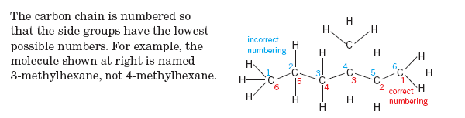
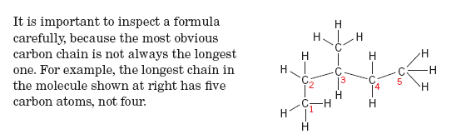
If there is no functional group present in the molecule, then the carbon chain is numbered starting at the end which will give the substituent/ branched/ side chain groups the smallest number.

Slide 65
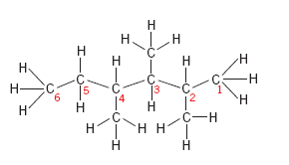
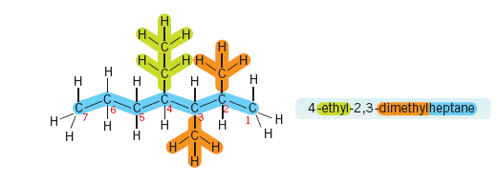

Slide 66
If there is more than one substituent group of the same type, we use commas between the numbers and the prefixes di-, tri-, or tetra- before the name of the groups.
If there are two or more different substituents, then they are given in alphabetical order.

Slide 67
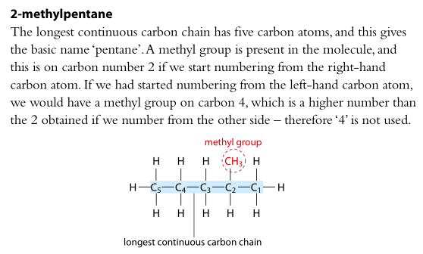

Slide 68
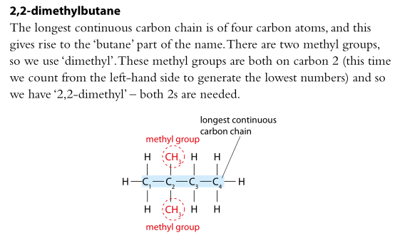

Slide 69
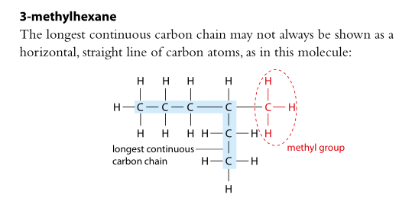
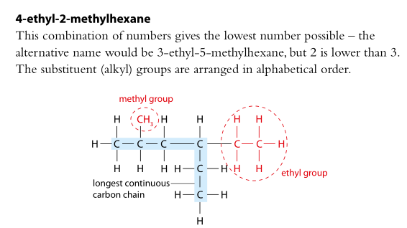

Slide 70
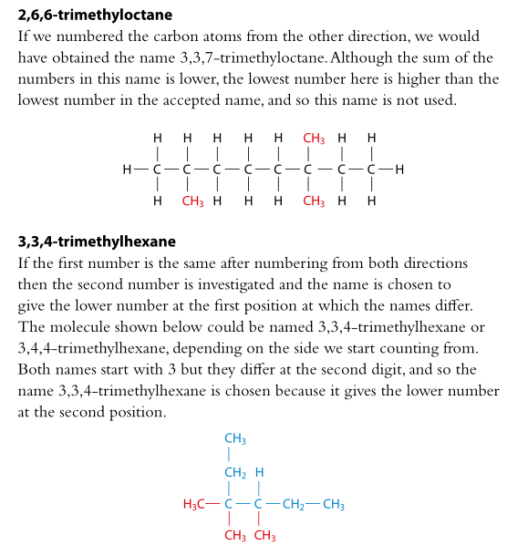

Slide 71
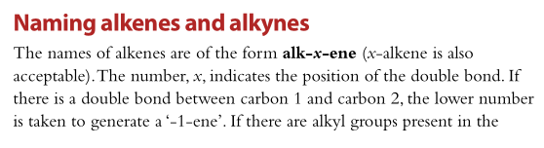
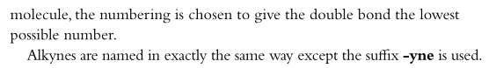

Slide 72
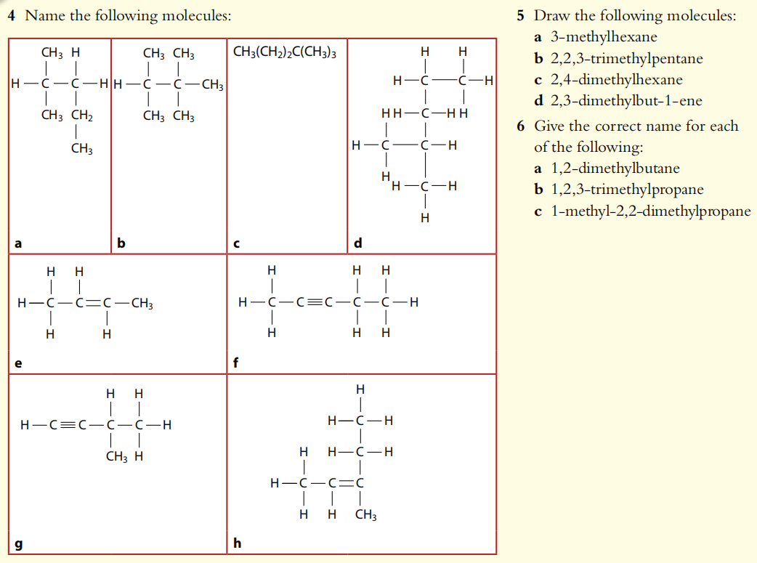

Slide 73
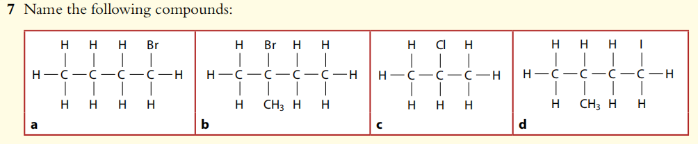
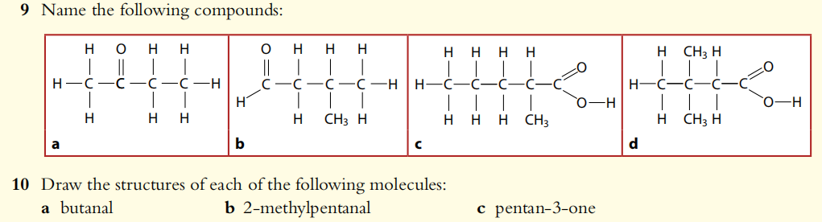
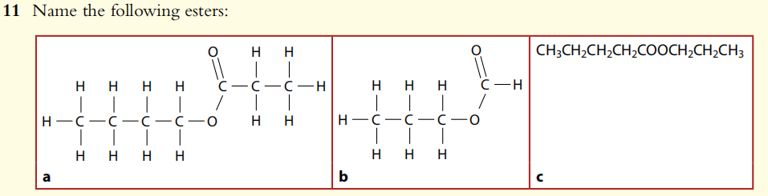

Slide 74
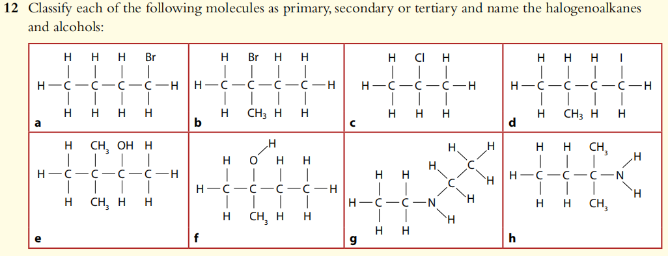
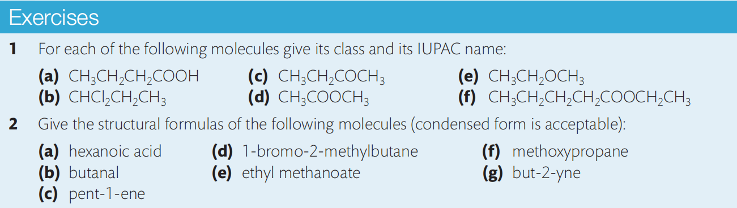

Slide 75
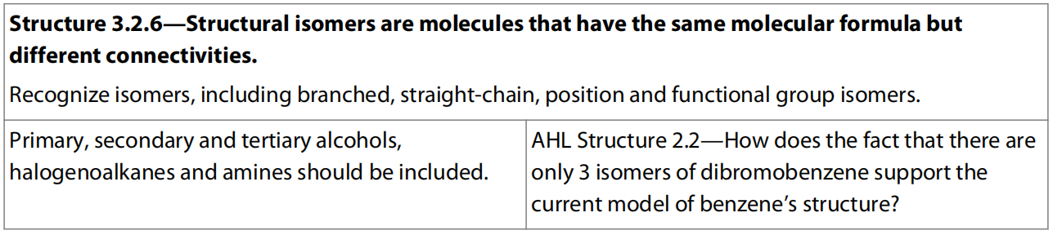
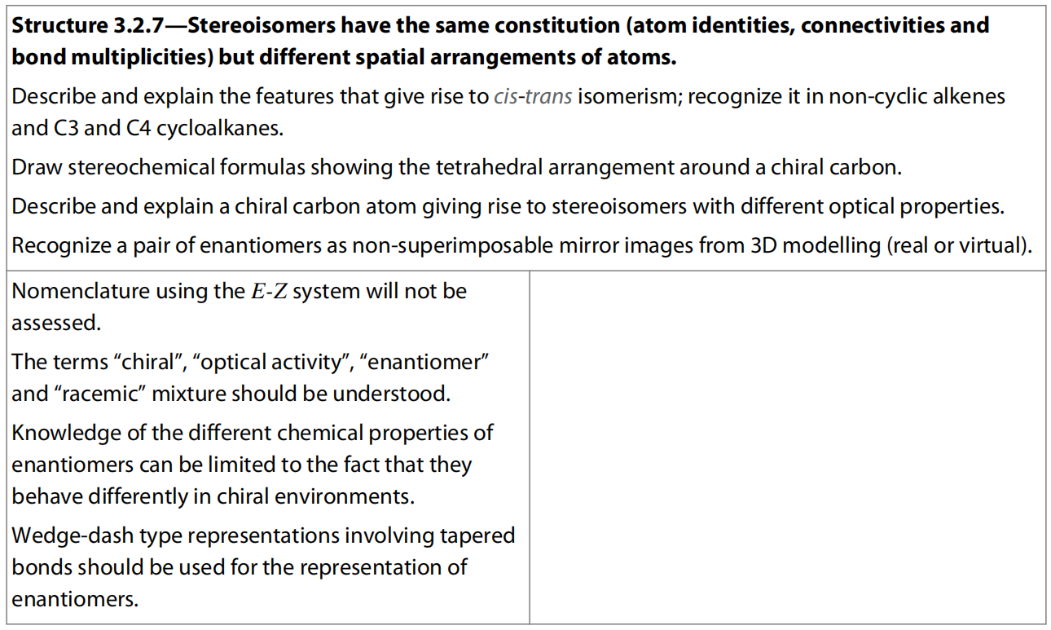
13.3 Isomers
HL Only

Slide 76
isomers
The molecular formula of a compound shows the atoms that are present in the molecule, but gives no information on how they are arranged.
Isomers are molecules with same molecular formulae but different structures.

Slide 77
Categories of isomers
Structural isomers: molecules having the same molecular formulae but the atoms are joined in a different order.
Stereoisomers: molecules with the same joining order of the atoms, but have a different arrangement of atoms in space and hence different three dimensional shapes.

Slide 78
Structural isomers
For example the formula C₄H₁₀.
There are two possible arrangements for these atoms that correspond to different molecules with different properties.
Each isomer is a distinct compound, having unique physical and chemical properties.

Slide 79
Positional isomers
Positional isomers: isomers that have the same hydrocarbon skeleton and the same and same number of functional group but have the functional group joined to a different part of the skeleton.
A simple example of this type of isomerism is propan–1–ol and propan–2–ol:

Slide 80
Hydrocarbon chain isomers
Hydrocarbon (carbon) chain isomers: isomers have different hydrocarbon skeletons that the functional group is attached to.
It is possible that there is no functional group in the carbon chain isomers at all.
Butane and methylpropane illustrate this type of isomerism:

Slide 81
Functional group isomers
Functional group isomers: isomers have different type of functional groups.
Because of their nature, some functional groups will usually have isomers containing another functional group.
For example alcohols usually have an alkoxyalkane that is isomeric to them, hence ethanol has an isomer methoxymethane:

Slide 82
Other common pairs of functional groups that display functional group isomerism with each other are:

Slide 83
In the case of positional and hydrocarbon chain isomers the functional group, which usually dictates the reactivity of the molecule, is unchanged therefore they have quite similar chemical properties.
With functional group isomerism the change in the functional group can have a profound effect on both the physical and chemical properties of the molecule.

Slide 84
In the previous example ethanol is a liquid (at room temperature and pressure) that will react with sodium to release hydrogen.
Sodium ethoxide is obtained as a white solid if excess ethanol is evaporated.
2 C₂H₅OH (l) + 2 Na (s) → 2 C₂H₅O⁻Na⁺ (eth) + H₂ (g)
Methoxymethane (at room temperature and pressure) is a gas, since there is no hydrogen bonding; and it does not react with sodium because it has no hydroxyl group.
Similarly methyl methanoate is a sweet smelling liquid that forms neutral solutions, whereas ethanoic acid has a sharp smell (vinegar) and forms acidic solutions.

Slide 85
The number of isomers that exist for a molecular formula increases with the size of the molecule.
This is one of the reasons for the vast number of compounds that can be formed from carbon.
Deducing the structural formulas and names for all possible isomers from a given molecular formula gives us a good opportunity to practice the earlier work on IUPAC nomenclature.
We will apply this to isomers in the first six members of the alkanes, the alkenes, and the alkynes.

Slide 86
Structural isomers in alkanes
C₄H₁₀ has two isomers, as shown before.
C₅H₁₂ has 3 isomers.

Slide 87
C₆H₁₄ has the following Isomers.
5

Slide 88
Structural isomers in alkenes
C₄H₈ has 2 straight-chain isomers:
Note that the molecules are named using the smallest numbered carbon that is part of the double bond.
Branched isomers?
Methylpropene
Why no number shown in the name at all?
What about C₅H₁₀, C₆H₁₂?

Slide 89
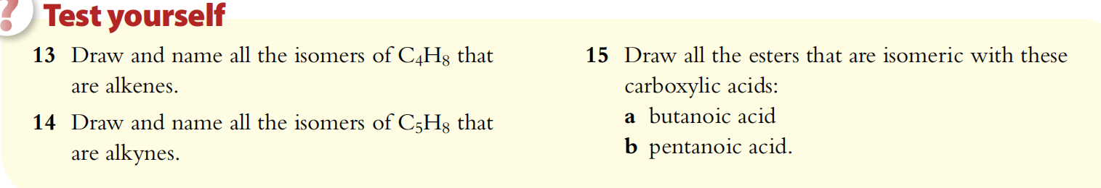
Draw and name all the structural isomers of C₄H₁₀O.
Draw all the structural isomers of C₄H₈O.

Slide 90
Trends in physical properties
We have seen that the structure of organic compounds can be thought of in two parts.
A functional group. This differs in identity in different homologous series. Both of these components influence the physical properties of a compound.
A framework consisting of carbon and hydrogen only, known as the hydrocarbon skeleton. This differs in size in different members of the same homologous series.
Most of these properties were discussed in relation to intermolecular forces in Chapter 4, and a few additional points are made here.

Slide 91
The increase in boiling point with carbon number that we saw in the alkanes applies to other homologous series.
In general, the lower members of a series are likely to be gases or liquids at room temperature, while the higher members are more likely to be solids.
Branching of the hydrocarbon chain also has an effect on volatility as it influences the strength of the intermolecular forces.
Branched-chain isomers have less contact with each other than their straight-chain isomers, and so have weaker intermolecular forces and so lower boiling points.
The straight-chain molecule butane has a higher boiling point (–0.5°C) than its branched-chain isomer, methylpropane (boiling point –11.7°C).

Slide 92
Owing to their different polarities and resulting differences in intermolecular forces, functional groups have a significant effect on volatility.
This can be summarized as follows.

Slide 93
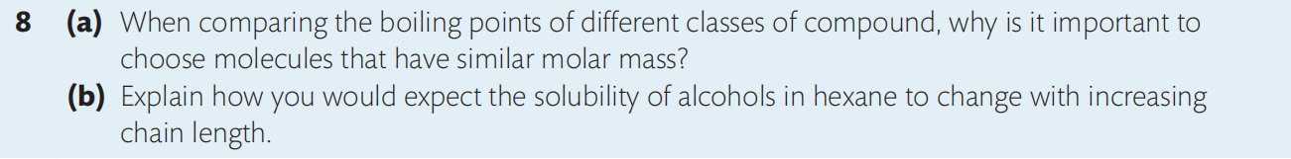

Slide 94
Stereoisomerism (Higher Level)
We saw that these have atoms attached in different orders and so are fundamentally different compounds from each other.
Structural isomers may have differences in the amounts of branching in their chains, or in the positions or the nature of functional groups.
Another type of isomerism, known as stereoisomerism, has molecules with atoms attached in the same order, but which differ from each other in their spatial or three-dimensional arrangement.
Whereas structural isomers can be represented relatively easily in two dimensions on paper, the study of stereoisomerism requires three-dimensional representation.

Slide 96
Conformational Isomers
Stereoisomerism can be further broken down into different types.
Conformational isomers usually spontaneously interconvert by rotation, and so in most cases cannot be isolated separately.
Some conformers of a compound, though, may be more stable than others, and so are favored.

Slide 101
Configurational isomers
Configurational isomers have a permanent difference in their geometry.
These isomers cannot be interconverted and they exist as separate compounds, with some distinct properties.
We will study in turn the two main groups of configurational isomerism here.

Slide 102
cis–trans and Z/E isomers
When there is some constraint in a molecule that restricts the free rotation of substituted groups, they become fixed in space relative to each other.
In these cases, the position of the groups must be described with respect to a reference plane.
There are two circumstances where these isomers arise.

Slide 103
1 Double bonded molecules
The double bond consists of one sigma (σ) bond and one pi (π) bond, with the π bond forming by sideways overlap of two p orbitals.
Free rotation around this is not possible as it would push the p orbitals out of position, and the π bond would break.
The reference plane is the plane of the π bond in the double bond.
2 Cyclic molecules
Cycloalkanes contain a ring of carbon atoms that restricts rotation.
The bond angles are strained from the tetrahedral angles in the parent alkane.
For example, in cyclopropane the carbon atoms form a triangle with bond angles of 60°, and in cyclobutane the atoms form a puckered square with approximate angles of 90°.
The reference plane is the plane of the ring.

Slide 104
Cis-Trans Isomers
When the molecule contains different groups attached to both of the carbon atoms on the double bond or to any two atoms on the ring, these can be arranged to give two different isomers.
The simplest examples, involving only two different substituents, form what are known as cis and trans isomers.

Slide 105
Cis refers to the isomer that has the same groups on the same side of the double bond or ring, while trans is the isomer that has the same groups on opposite sides, or across the reference plane.
These prefixes are given in italics before the name of the compound.

Slide 109
There are, however, many cases in alkenes where the cis–trans designation breaks down.
This happens when the carbon atoms of the double bond are bonded to all four different substituents.
Consider, for example, 1-bromo-2-methylbut-1-ene.

Slide 110
z/e isomerism
As all the groups attached to the double bond are different, there are no ‘same groups’ to position relative to the reference plane.
For these cases, a more comprehensive naming system has been developed, known as Z/E isomers.
Z/E isomerism is based on the so-called Cahn–Ingold–Prelog rules of priority, which are applied in turn to the groups on each end of the double bond.

Slide 111
The priority rules get complicated in many cases, but for our purposes can be summarized as follows:
Rule 1: Look at the atom bonded to the carbon of the double bond. The atom with the higher atomic number has the higher priority.
Rule 2: If the atoms are the same, for example if they are both carbon atoms, apply the same rule to the next bonded atom. This means that longer hydrocarbon chains have higher priority.
Br > Cl > F > OH > NH₂ > C₃H₇ > C₂H₅ > CH₃ > H
Be aware that –OH and –NH₂ would not directly bond to C=C because of their instability.

Slide 112
Next we compare the positions of the highest priority groups on the two carbons of the double bond.
If the two highest priority groups are on the same side of the double bond then the isomer is ‘(Z)’.
If the two highest priority groups are on the opposite side of the double bond, they are labelled as ‘(E)’.

Slide 113
When we apply these rules to the example above, we find:
1. Br has the higher priority of the two groups attached to the left-hand carbon and
2. C₂H₅ has the higher priority of the two groups attached to the right-hand carbon.

Slide 114
As the two highest priority groups are on the same side, this is the (Z) isomer.
If they were on opposite sides it would be the (E) isomer.
This process may sound more complicated than it really is, but becomes clearer with examples.

Slide 116
We can see that the Z/E convention has wider application than cis–trans, and is therefore being used increasingly in both organic and inorganic nomenclature.
Cis and trans and Z/E isomers may have some different physical properties depending on the influence of the substituted groups on polarity and the shape or symmetry of the molecules.
Boiling points, melting points, and solubility data are therefore reported separately for each isomer.

Slide 117
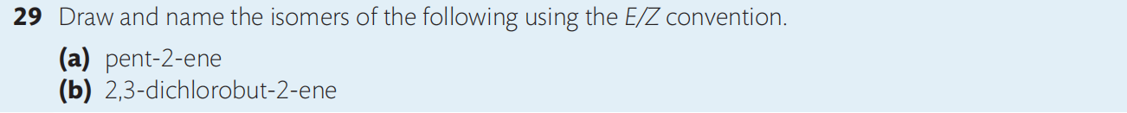
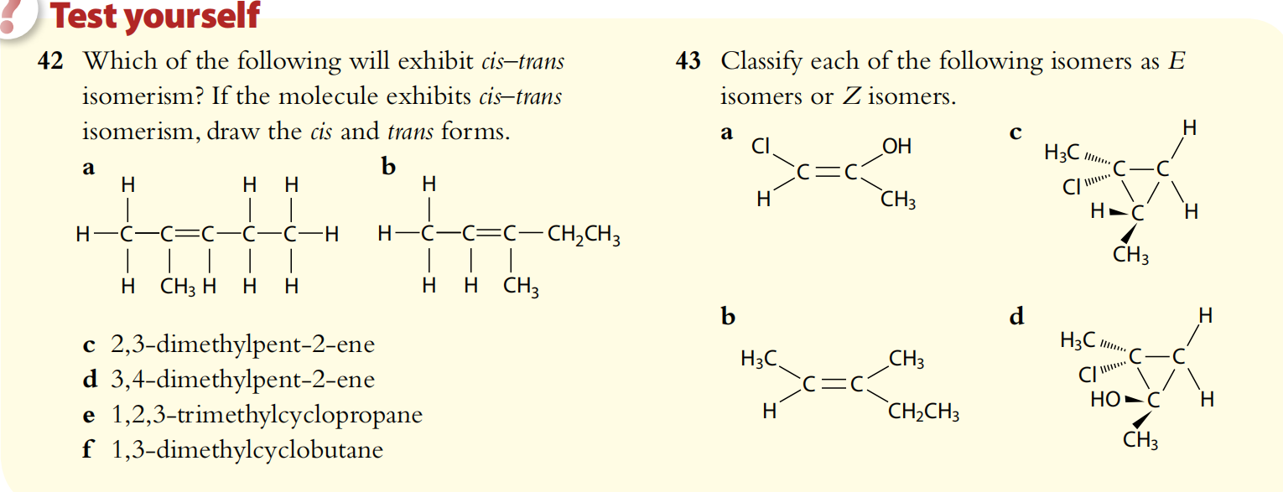

Slide 118
Optical isomers
A carbon atom attached to four different atoms or groups is known as chiral.
It is alternatively known as asymmetric or as a stereocenter.
The four groups, arranged tetrahedrally around the carbon atom with bond angles of 109.5°, can be arranged in two different three-dimensional configurations which are mirror images of each other.
This is known as optical isomerism.
The term refers to the ways in which the isomers interact with plane-polarized light, which will be discussed below.
They are said to be chiral molecules and have no plane of symmetry.

Slide 120
If you look at your two hands you will see that they also are mirror images. When you put them on top of each other, the fingers and thumbs do not line up – we say they are non-superimposable.

Slide 121
We can find optical activity in many of the molecules we have already encountered in this chapter.
The clue is to look for any carbon atom that is bonded to four different groups.
It is often useful to mark that carbon with a red asterisk.

Slide 122
The same is true for optical isomers, and the two non-superimposable forms are known as enantiomers.
A mixture containing equal amounts of the two enantiomers is known as a racemic mixture or a racemate.
As we will see, such a mixture is said to be optically inactive.
Many molecules have more than one chiral centre, and so can give rise to different configurations at each position.
Enantiomers have opposite configurations at each chiral centre, which is why the molecules are mirror images of each other.
But when molecules have different configurations at one or more, but not all, chiral centers, they are known as diastereomers and are not mirror images of each other.
Common sugars are often diastereomers of each other, such as glucose and galactose.

Slide 124
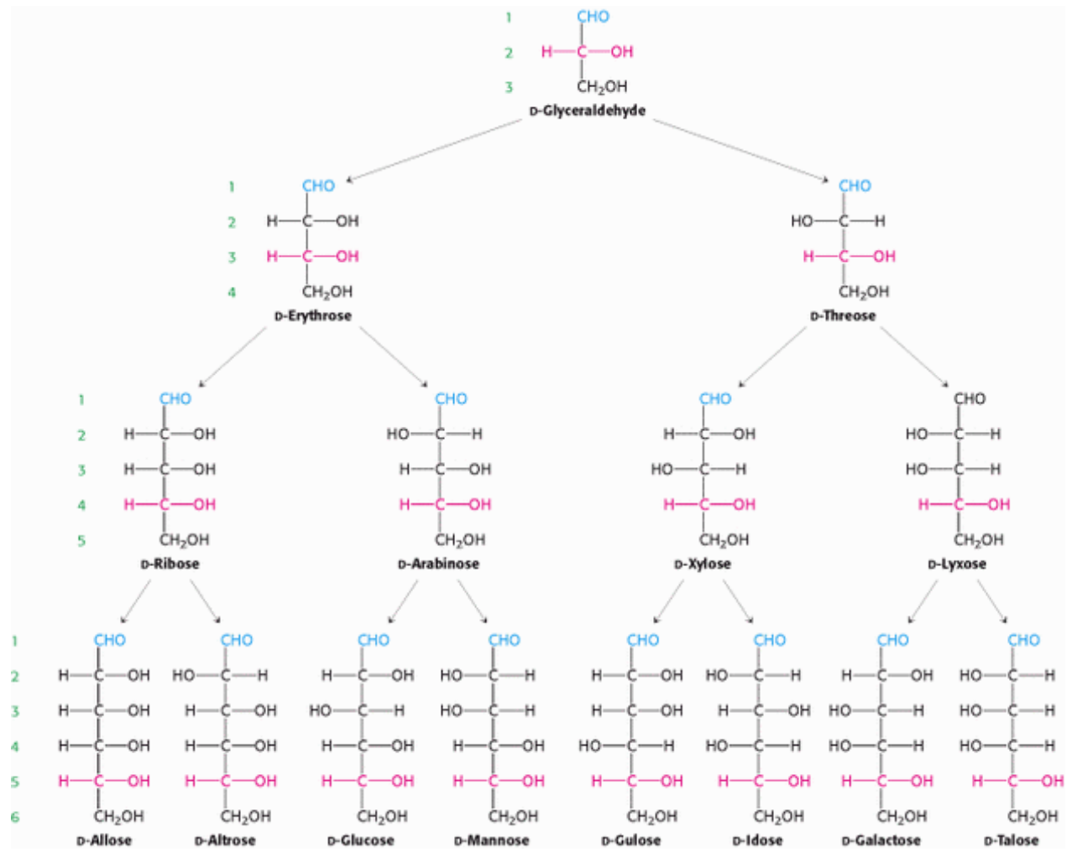

Slide 126
Properties of enantiomers
Diastereomers usually differ from each other in their physical and chemical properties.
Enantiomers, on the other hand, have identical physical and chemical properties – with two important exceptions.

Slide 127
1. Optical activity
As we know from their name, optical isomers show a difference in a specific interaction with light.
A beam of ordinary light consists of electromagnetic waves that oscillate in an infinite number of planes at right angles to the direction of travel.
If, however, this light is passed through a device called a polarizer, only the light waves oscillating in a single plane pass through, while light waves in all other planes are blocked out, and this is known as plane-polarized light.

Slide 128
A similar effect is achieved in polarized sunglasses or windshields to reduce glare.
In the early 1800s it was discovered that when a beam of plane-polarized light passes through a solution of optical isomers, they rotate the plane of polarization.
The amount and direction of rotation can be measured with an instrument called a polarimeter.

Slide 129
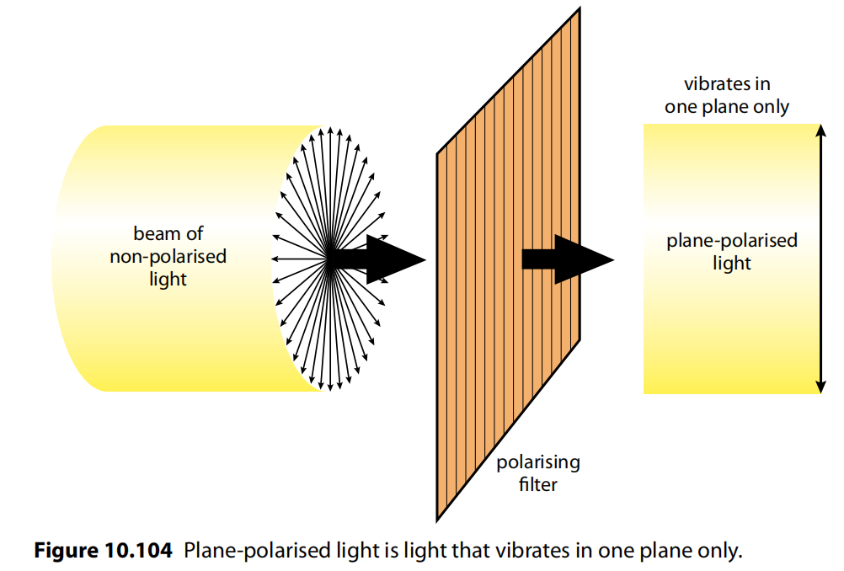
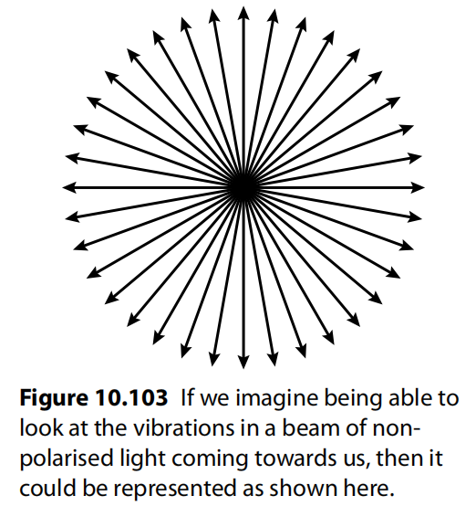
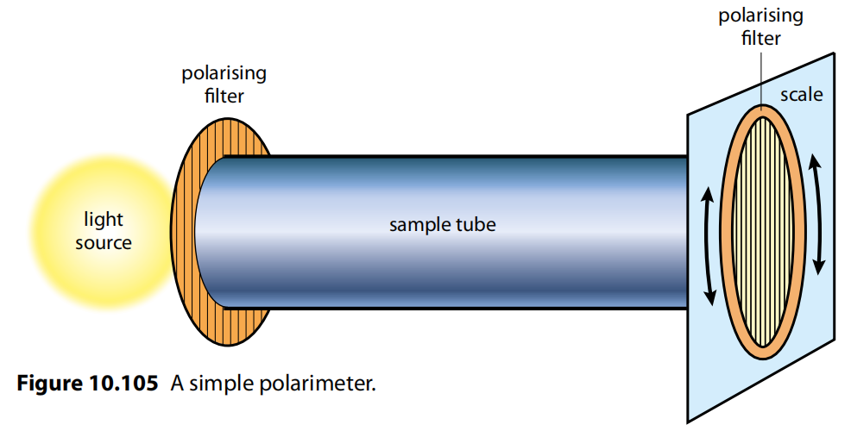

Slide 131
The solution of isomers is placed in the sample tube through which plane-polarized light is passed.
Rotation of the polarization plane occurs and the light then passes through a second polarizer called the analyzer.
This can be rotated until the light passes through it and so the extent and direction of rotation can be deduced.
In order to compare different solutions, the concentrations of the solutions, the wavelength of light used, and the sample path length must all be kept the same.

Slide 132
Separate solutions of enantiomers, at the same concentration, rotate plane-polarized light in equal amounts but opposite directions.
This is what is meant by being optically active.
A racemic mixture does not rotate the light and so is said to be optically inactive.
Naturally occurring chiral molecules are optically active, in other words they exist as only one enantiomer.
For example, morphine rotates plane-polarized light to the left (anticlockwise) so is said to be (−), whereas sucrose rotates it to the right (clockwise) and is said to be (+).

Slide 133
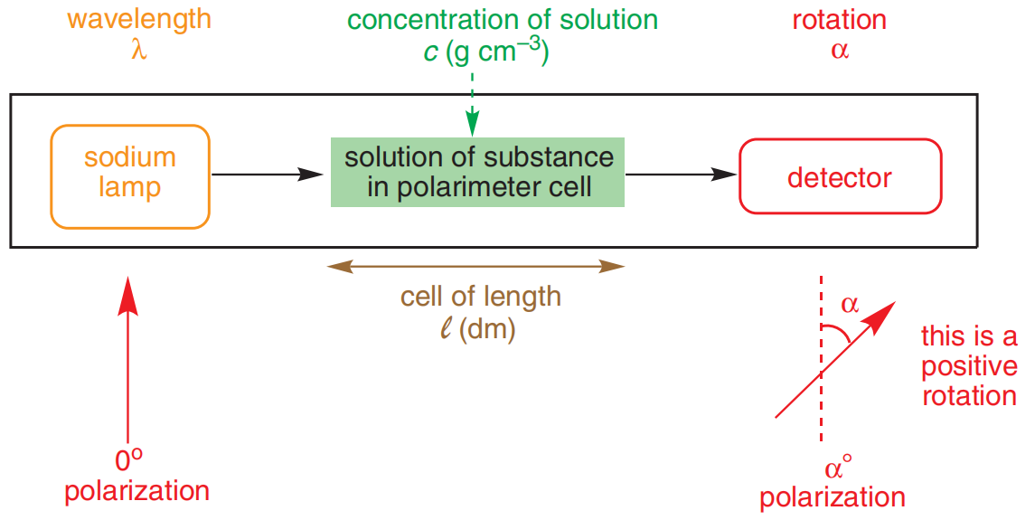
Calculation of rotation (not required)
α = [α] l c where
α is the observed rotation,
[α] is the specific rotation of this specific substance,
l is the length of the path that the polarized light passes through
c is the concentration of the substance.

Slide 134
2. Reactivity with other chiral molecules
When a racemic mixture is reacted with a single enantiomer of another chiral compound, the two components of the mixture, the (+) and (−) enantiomers, react to produce different products.
These products have distinct chemical and physical properties and so can be separated from each other relatively easily. This is therefore a means by which the two enantiomers can be separated from a racemic mixture, a process known as resolution.

Slide 135
The different reactivity of a pair of enantiomers with another chiral molecule is of particular significance in biological systems because these are chiral environments.
An infamous example of this occurred in the 1960s when the drug thalidomide was prescribed to pregnant women for morning sickness.
One enantiomer is therapeutic but the other produces severe malformations in the fetus.
This tragedy largely spearheaded research into processes for the manufacture of a single enantiomer using a chiral catalyst.
The process, known as asymmetric synthesis, led to the Nobel Prize in Chemistry in 2001.

Slide 136
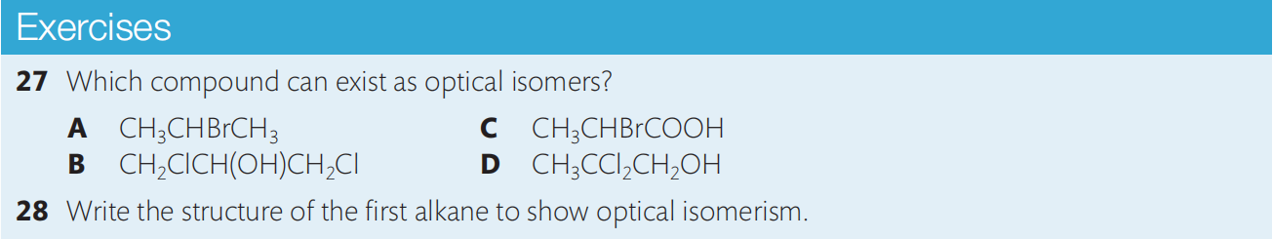
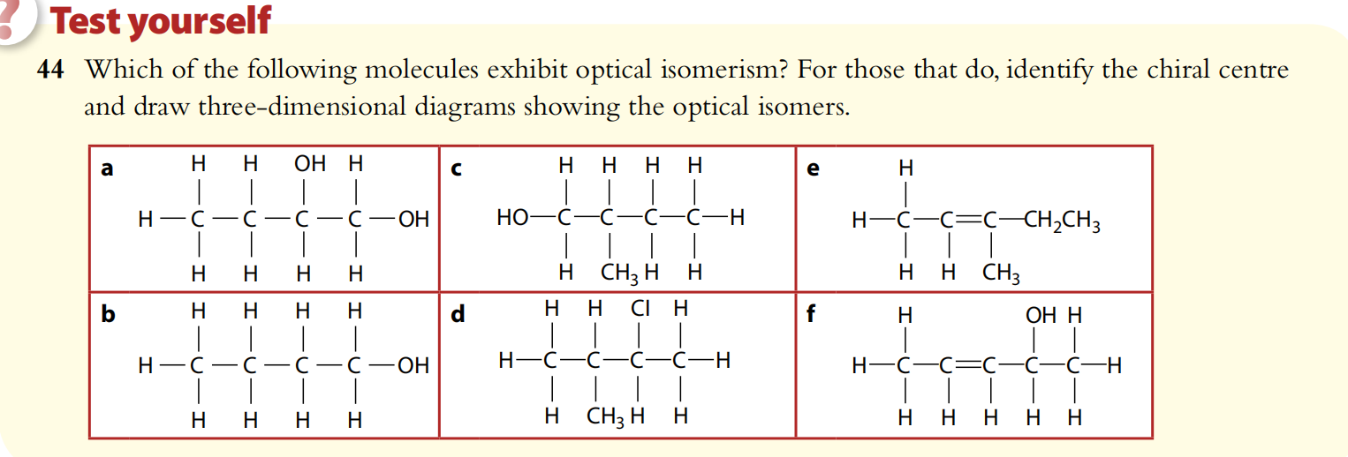

Slide 137
